Slide 1

Monarch High School
Bookkeeping Procedures

Slide 2
First Step to Fundraising
Sponsor must fill out a SAN Form: School Activity Notification Form
Submit this the Mr. Klemke or Ms. Hendricks for approval.
When it is approved, it will be forwarded from Mr. Klemke or Ms Hendricks to the bookkeeper.
If there is a collection involved, the sponsor must see the bookkeeper and sign out the appropriate document ( money collection envelope for collection 15.00 or under; receipt book for any collection over 15.00) for receiving cash BEFORE starting to collect cash. No personal checks accepted.
Remember, you will want to pay the sales tax on your purchase for any items you are selling as a fundraiser. If you do not pay on the front end, you will have to pay on the total that you sell.
Financial reports/Statement of Revenue must be completed within 10 days of completion of the fundraiser.

Slide 3
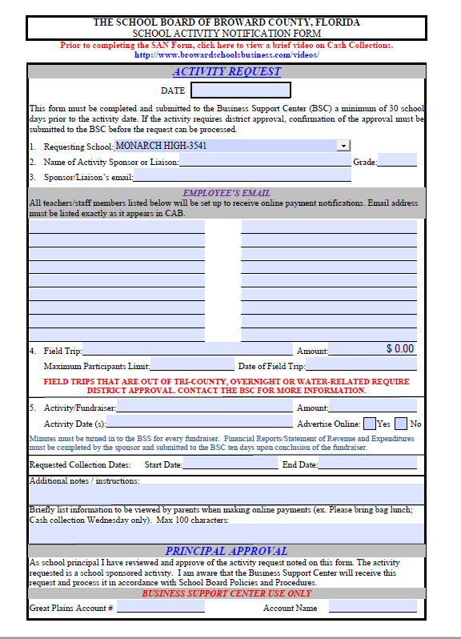
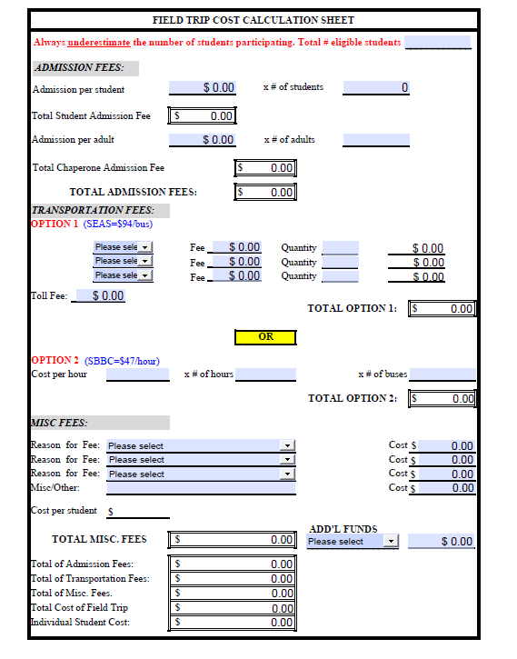
Sample SAN Form
Informational page
Calculation page

Slide 4
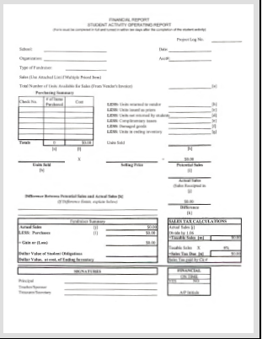
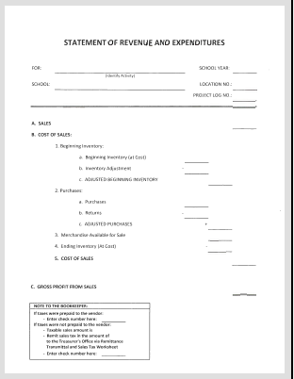
Sample Financial Report - Stmt of Revenue

Slide 5
Paperwork for Every Financial Report or Statement of Revenue
In order for either of these reports to be complete, the following needs to accompany them:
Trial balance (request from me)
Copy of all signed receipts or invoices
Any online sales reports (request from me)

Slide 6
San Form Information
Make sure all information is printed on the form. A description of your activity should be brief but informative so when placed online, the parents understand what they are paying for. If your description runs OFF the space on the SAN FORM, please put the full description in the body of your email.
Make a point to learn your account number and use of sub accounts.

Slide 7
Using a SAPO – School Approved Purchase Order
Before ordering anything for a club, class or activity, you must get a quote for whatever you are purchasing and fill out a SAPO and submit to bookkeeper for account balance confirmation and Admin approval. The only fund accounts that can be temporarily in the red are fundraiser accounts.
Once approved & signed by the Principal, the SAPO will be assigned a number and returned to you. At this point, you will send a copy of the SAPO along with the quote to the vendor. After (and only after) you received your merchandise, you can submit the invoice along with the “request for payment” form for the vendor to be paid.
The SAPO is not a form of payment. You must submit the invoice promptly after receiving your merchandise.

Slide 8
When to use a SAPO
SAPO USED for ALL:
T-Shirts
Awards
Stoles/Cords
Sports Equip
Uniforms
Fundraisers
Buses
Music
If you are not sure, ask.

Slide 9
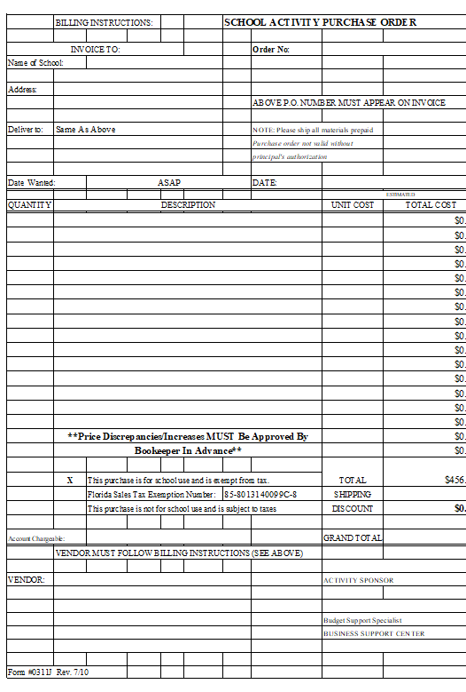
Sample SAPO
This form should be done online so it will calculate correctly.
Remember to input current date, full school name and address and full vendor name and address.

Slide 10
ISRO (Independent School Related Organizations)
ISRO (PTA, PTO, Athletic boosters, Band patron groups, etc.)
All activities must be approved by the principal
ISRO (Independent School Related Organization) may not charge parents a fee for instructional materials, equipment, or supplies related to the school program or activities.
Letter of agreement must be on file. If no letter of agreement is executed, it is considered sponsored by the school. Therefore, run through Internal Accounts.
Field trips must be run through internal accounts. ISRO may donate funds to the school to pay for expenses.
School Board employees are NOT allowed to collect or handle money for ISRO sponsored activities and Non-School Board employees are not allowed to handle money of school sponsored activities. (can only reimburse school board employees)
ISRO must have their own address and own bank account and must be incorporated by the state of Florida.

Slide 11
Requesting Reimbursement
Before making any purchase for reimbursement, you must check on account balances.
Make all reimbursement requests using the “Expense Reimbursement- Payment Form”.
You must attached any and all receipts/invoices.
Every receipt/invoice needs your signature directly on it.
Make sure you put the assigned SAPO number on the form along with where you need the check to go. You must check “deliver to school” of “mail check”.

Slide 12
Hints for the Expense-Payment form
NO STAPLES
Tape all receipts to a clean sheet of paper and attach to request form.
Sign all receipts/invoices
Check where to send check
Put SAPO number on form
Sign bottom left as sponsor
Make sure correct account number is on top of form; if subaccounts are used, be sure to use the correct account number.
All club – class or athletic accounts must have signed minutes with the payment form. If unsure, ask.

Slide 13
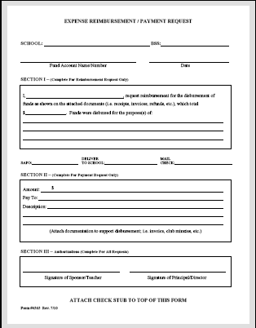
Sample Expense – Payment Form

